Slide 1


SMART AGRICUTLURE
Sponsored By
Your Team Name : Innovator
Your team bio : Jnaneshwar B.T.
+91-6362847265
Date : 25th Apr 2023

Slide 2
Problem Statement
Agriculture is an important sector of the global economy, farmers face several challenges and problems which can result in crop failures, reduced yields, and loss of livelihoods for farmers and impacts on economical growth.
Climate change is impacting agriculture in various ways, like erratic weather patterns, extreme temperatures, prolonged droughts, and increased frequency of natural disasters.
Limited access to water resources, over-extraction of groundwater, and inefficient water management practices can lead to water scarcity in agricultural regions.
Soil degradation, caused by factors such as erosion, nutrient depletion, and chemical contamination, can result in reduced soil fertility.
Agricultural practices can have negative environmental impacts, such as deforestation, water pollution, and excessive use of fertilizers and pesticides.
Pests and diseases can significantly impact crops and livestock.
Farmers often face challenges in accessing markets, both domestically and internationally.
The technology and innovation gap can hinder agricultural productivity and limit farmers' ability to adapt to changing environmental conditions.
Many farmers face challenges related to rural poverty &
Labor shortages in agriculture.
Habitat loss: Agricultural expansion can lead to deforestation, conversion of natural habitats, and fragmentation of wildlife habitats, resulting in loss of wildlife habitat, displacement of wildlife populations, and decline in biodiversity
Agricultural policies and governance can significantly impact the agricultural sector. Issues such as land tenure, access to credit, trade policies, and agricultural subsidies can affect farmers' ability to access resources, compete in markets, and adopt sustainable practices.

Slide 3
User Segment & Pain Points
Farmers : Farmers are not upgraded to modern technology and face many challenges accessibility to market. If they use IoT based solution, will increase the productivity and can export their product globally.
Agriculture supply Chain. It is sequence of activities involved in producing, processing, storing, transporting, and distributing agricultural products from farm to consumer. It encompasses all the steps and stakeholders involved in the journey of agricultural products, including farmers, producers, processors, distributors, retailers, and consumers.
Warehouse Management: In the ware house, monitor and maintain the environmental conditions like temperature, humidity and air quality, security system.

Slide 4
Pre-Requisite
Developer shall have knowledge about the software, electronics and mechanical. Mechtronics.
Have skillsets about the Cloud computing, firmware development, C,C++, Linux , Device Driver, Hardware design,
Drone. Shall be used to sprinkled water & presiside .
Protecting the agriculture crops from wild life.
Robotic Arm in Wearhouse.
IoT Environmental monitoring system.
Software for electric Agri vehicles.
Database Server, Web Server, Azure framework.
Sensors, Hardware boards, Touch Screen display, OS, High End Development machine, Development tools, compiler, linker debugger. Server Machine.
License Keys.
Fund.

Slide 5
Tools or resources
Azure IoT Hub.
Azure IoT Edge : Artificial Intelligence
Azure Stream Analytics.
Azure Time Series Insights
Azure IoT Central.
Azure IoT Device Provisioning Service
Sensors, Hardware boards, Touch Screen display, OS, High End Development machine, Development tools, compiler, linker debugger. Server Machine. Oscilloscope
Machine.

Slide 6
Methodology & Architecture
Infrastructure optimization: Azure provides a range of infrastructure optimization tools that can be used to reduce energy consumption and carbon footprint. For example, the Azure Energy Efficiency calculator can be used to calculate the energy consumption of Azure virtual machines and recommend ways to optimize energy consumption.
Cloud-native architecture: Cloud-native architecture refers to the design and deployment of software applications that are optimized for cloud computing environments. This involves using services and tools that are designed specifically for the cloud, such as Azure Kubernetes Service (AKS) and Azure Functions. Cloud-native architecture can help reduce energy consumption and carbon footprint by optimizing resource utilization and scaling.
Serverless computing: Serverless computing is a cloud computing model in which the cloud provider manages the infrastructure and automatically allocates resources as needed. This can help reduce energy consumption and carbon footprint by eliminating the need for dedicated server infrastructure. Azure Functions and Azure Logic Apps are examples of serverless computing services provided by Azure.
Sustainable data centers: Azure has made significant investments in building sustainable data centers that are designed to minimize energy consumption and carbon footprint. These data centers are powered by renewable energy sources and are equipped with energy-efficient hardware and cooling systems.
Smart Agriculture development practices: Adopting green software development practices can help reduce the environmental impact of software development. These practices include optimizing code for energy efficiency, minimizing resource usage, and reducing waste generation. Azure provides a range of tools and services that can be used to implement these practices, such as Azure DevOps and Azure Advisor.

Slide 7
Key Differentiators
Azure Sustainability: Microsoft has made significant investments in building sustainable data centers and improving energy efficiency, making Azure a leading cloud provider smart agriculture.
Comprehensive Tools: Azure provides a range of tools and services that can be used to develop and deploy green software, including serverless computing, Kubernetes, and DevOps tools.
Integration with Other Microsoft Products: Azure integrates well with other Microsoft products, such as Power BI, Dynamics 365, and SharePoint, providing a seamless user experience for developing and deploying green software.
Flexibility and Scalability: Azure offers a flexible and scalable infrastructure that can be customized to meet the unique needs of smart agriculture applications.
Security and Compliance: Azure provides a range of security and compliance features, such as encryption, access controls, and compliance certifications, ensuring that smart agriculture applications are secure and compliant with regulations.

Slide 8
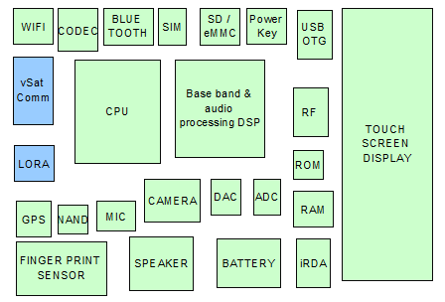
Blocks of Hardware platform
Water Level Sensor
Temperature Sensor
Soil Moisture Sensor
Light Sensor

Slide 9
Key Differentiators
Precision farming: Smart agriculture uses precision farming techniques that enable
farmers to monitor and manage crops with more accuracy, thereby increasing
yield and reducing waste.
Data-driven decision making: Smart agriculture relies on data collection and analysis to
inform decision making. This can lead to more efficient use of resources, better crop
management, and increased profitability.
Remote monitoring: Smart agriculture allows farmers to monitor crops and livestock
remotely using sensors and other IoT devices. This reduces the need for physical
inspections, which saves time and resources.
Automation: Smart agriculture uses automation technologies such as robotics and
drones to perform tasks like planting, harvesting, and monitoring crops.
This increases efficiency and reduces labor costs.
Sustainable practices: Smart agriculture incorporates sustainable farming
practices that aim to reduce environmental impact and promote long-term
sustainability. This includes using natural fertilizers, conserving water, and
reducing greenhouse gas emissions.

Slide 10
Adaptation Plan
Define the goals and objectives: The first step is to define the goals and objectives of the smart agriculture system. The goals can include increasing crop yield, reducing water usage, improving soil health, and minimizing the use of pesticides.
Evaluate the current system: The next step is to evaluate the current agricultural practices and identify the areas that can be improved. This can include analyzing the soil quality, water availability, and crop yield.
Identify the technology: Once the goals are defined and the current system is evaluated, the next step is to identify the appropriate technology that can be used to achieve the goals. This can include sensors, drones, automated irrigation systems, and data analytics.
Develop a plan: Based on the goals, evaluation, and technology identification, develop a comprehensive plan that includes the timeline, budget, and resources required for implementing the smart agriculture system.
Pilot test: Before implementing the system on a large scale, it is recommended to conduct a pilot test to identify any issues and refine the system.
Monitor and evaluate: Once the system is implemented, it is important to continuously monitor and evaluate the system's performance to identify any areas that need improvement.
Training: To ensure successful implementation and adoption of the smart agriculture system, it is important to train the farmers and other stakeholders on how to use the technology effectively.
Scale-up: After the pilot test is successful, the smart agriculture system can be scaled up for broader adoption.
Continuous improvement: Finally, it is important to continuously improve the system by incorporating new technology and practices that can further enhance the efficiency and sustainability of the agriculture practices.

Slide 11
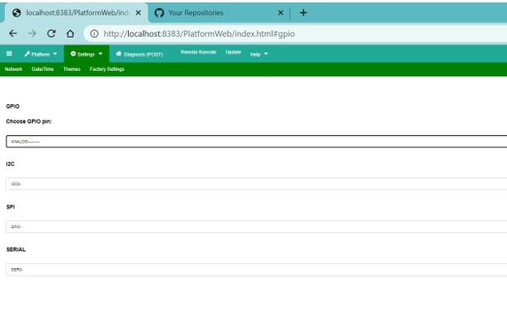
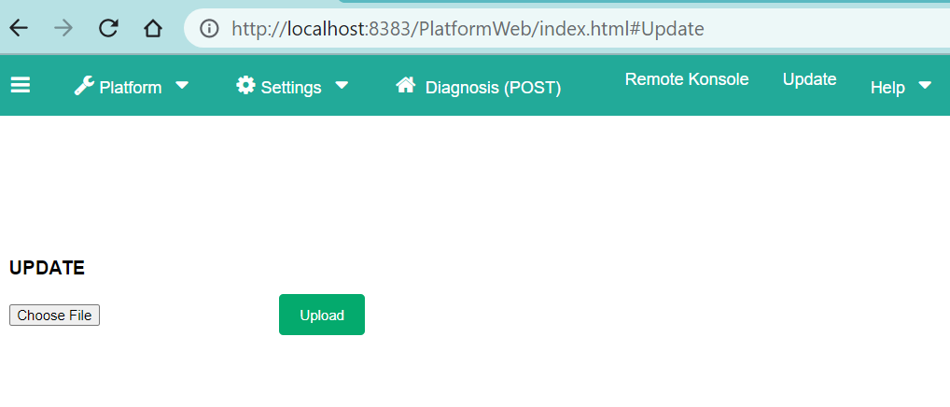
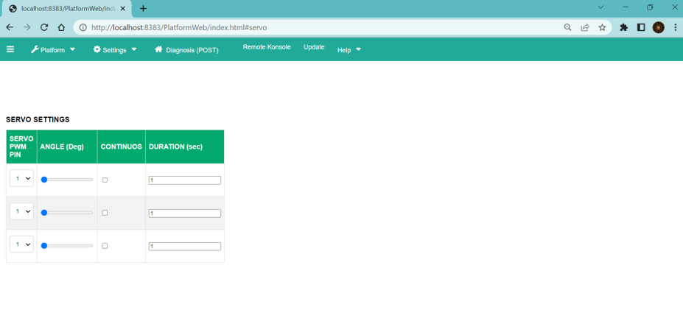
GitHub Repository Link & supporting diagrams, screenshots, if any
https://github.com/jbt1607/Sustainability-Hack.git
https://github.com/jbt1607/Sustainability-Hack/tree/main/Idea/sources/SmartAgriculture
Web based IoT Device(ESP32) Control panel & Monitoring System

Slide 12
Thank You
Jnaneshwar B.T.

